Slide 1
CustomerAnalysis
File created on: 8/15/2022 7:06:22 AM

Slide 2
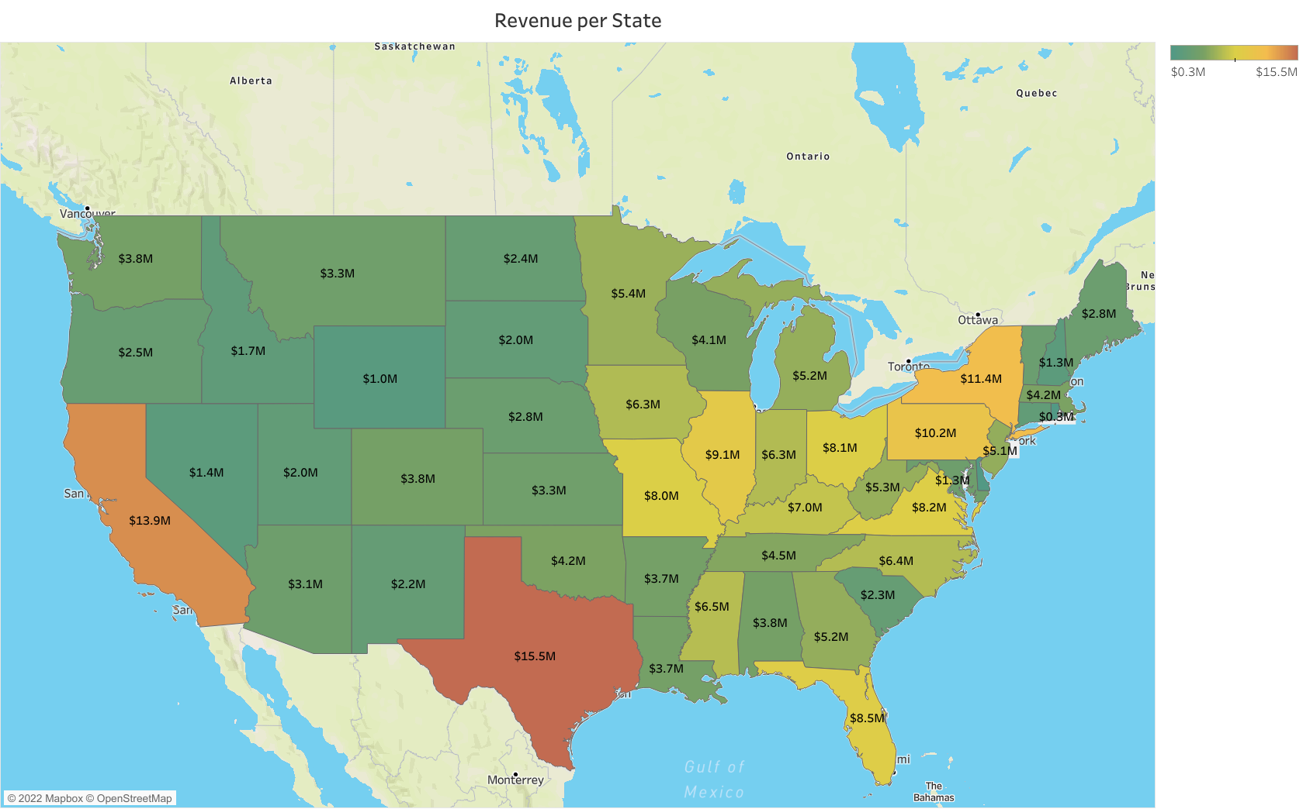

Slide 3
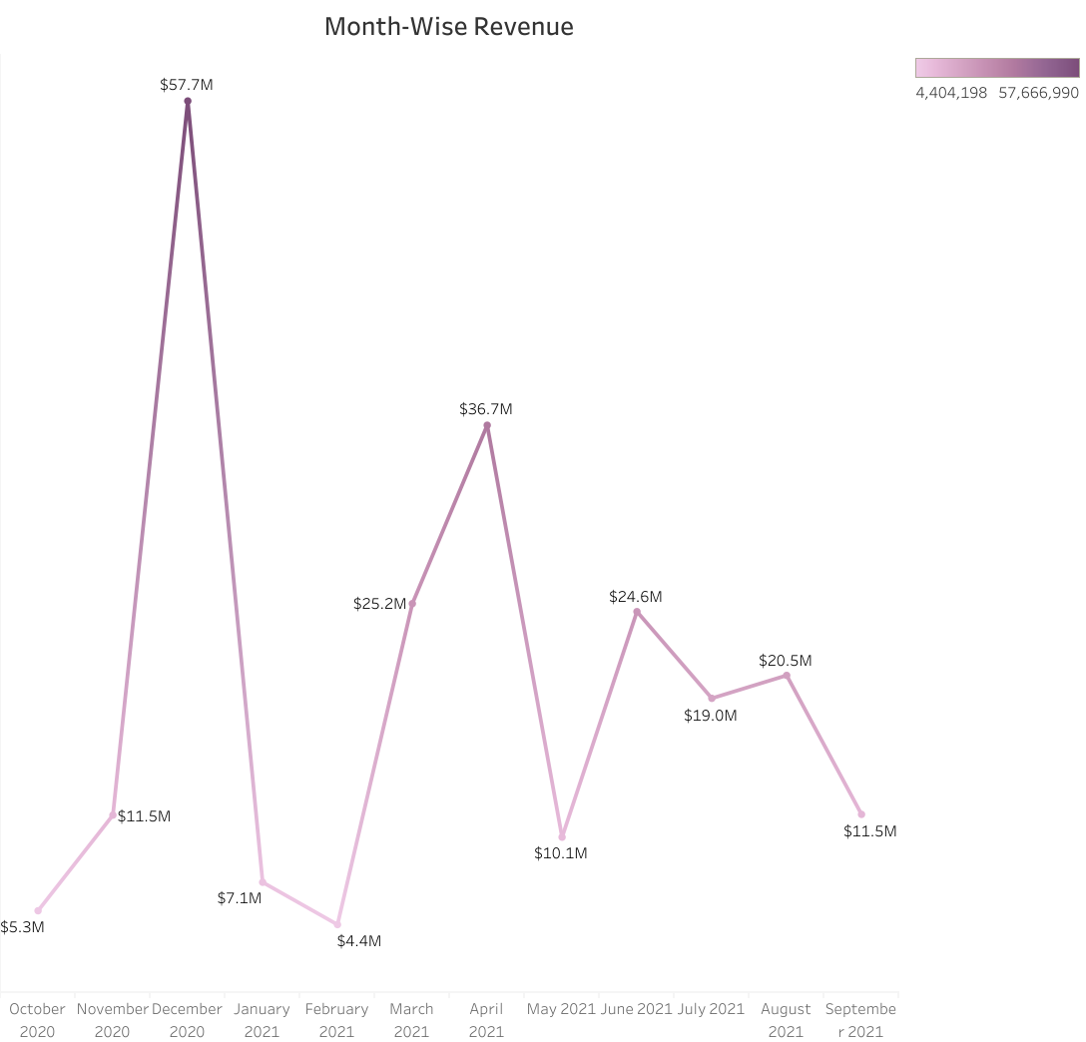

Slide 4
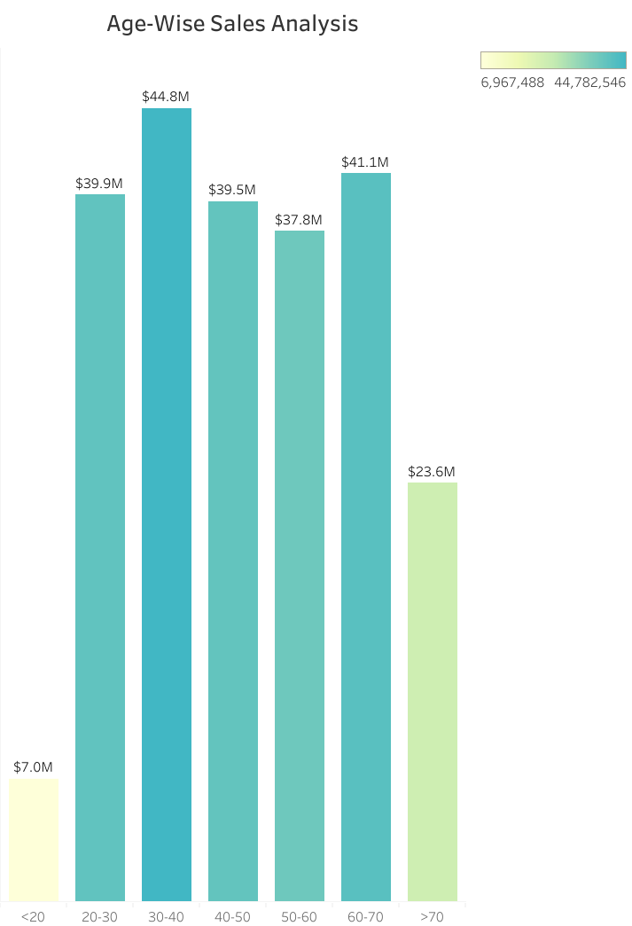

Slide 5
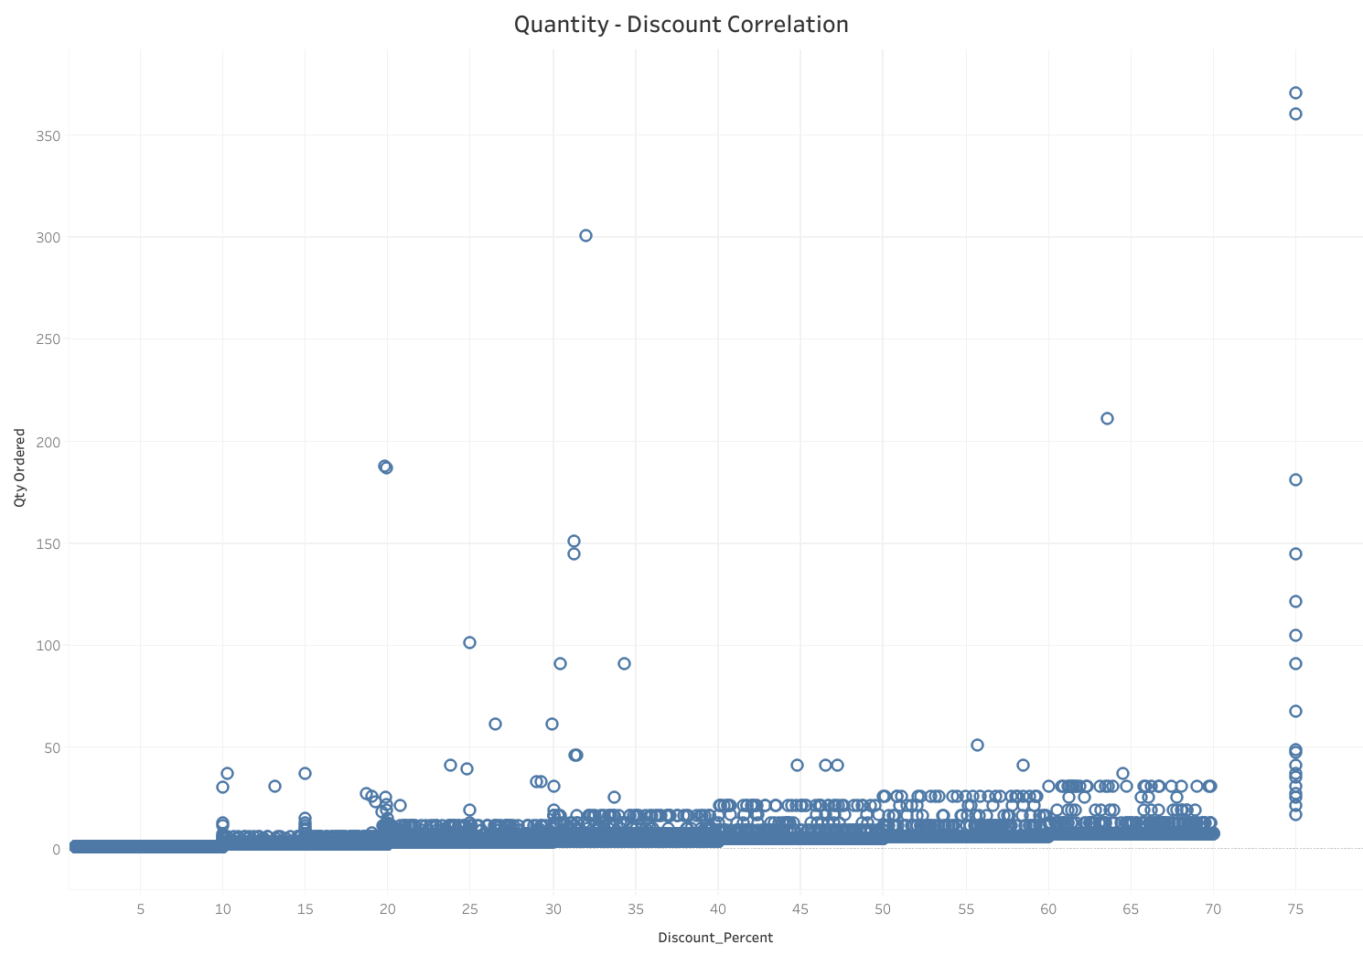

Slide 6
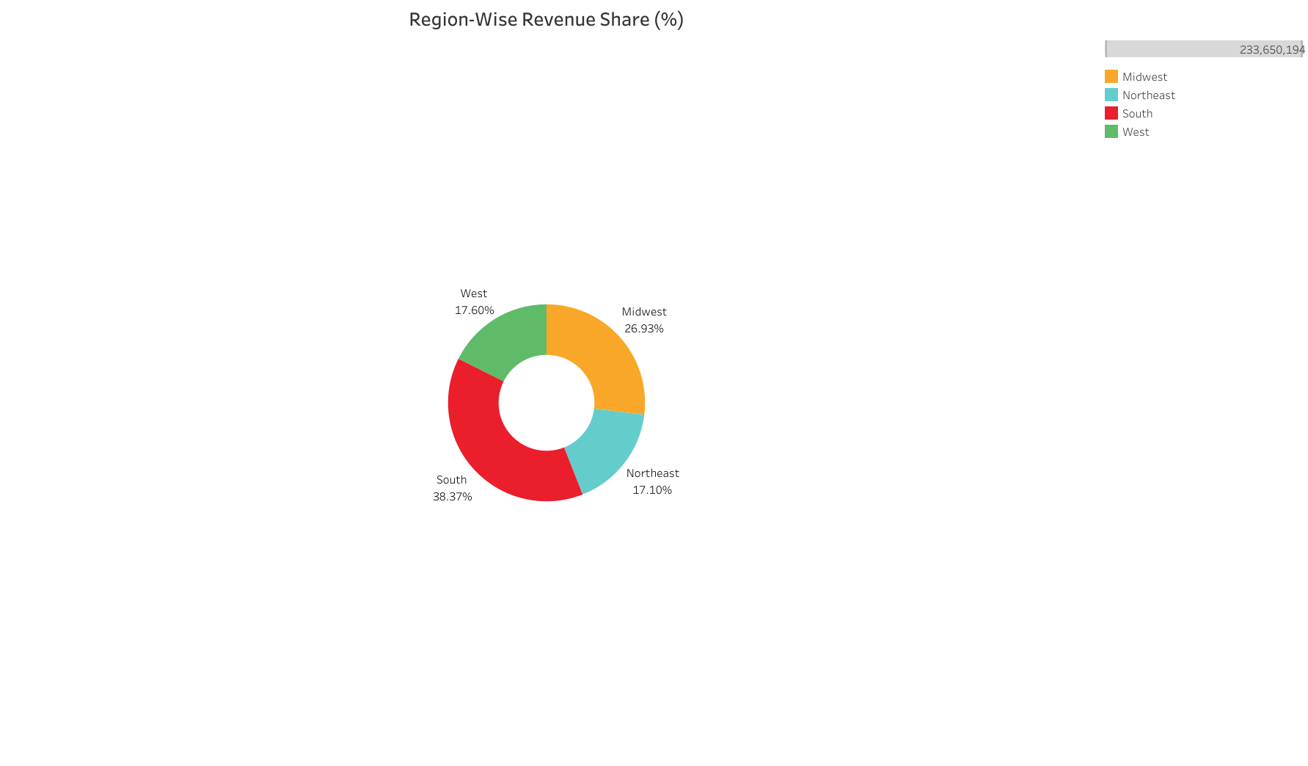

Slide 7


Slide 8
